Slide 1
Seminar on Grant Writing
Randy Gollub, MD PhD
Psychiatrist, Massachusetts General Hospital
Associate Professor of Psychiatry, Harvard Medical School
Why N How, 04/28/2014
With thanks to Professor Scott Lukas, PhD, McLean Hospital for materials on content development

Slide 2
Why Are Grant Applications Important?
Success in research is measured by the impact and quality of publications (only secondarily by the number of papers)
Grants are necessary to pay your salary if you have a “soft money” position, to fund research and to advance academic rank
Only well executed grant applications are funded- all are very competitive

Slide 3
How to write a successful grant Step 1: The Idea
Competition for grants is extremely high. No sloppiness in grant preparation will be tolerated (proofread & edit!).
Good grant applications:
Address a previously unanswered scientific question or seek to resolve controversies in a known body of knowledge
Develop specific aims, as well as feasible methods and a reasonable hypothesis for each aim
Only write fundable grants
The climate of research changes fast
Discuss the project with mentors to determine if it is fundable
Some areas of research receive priority. Your grant has a greater chance of being funded if it matches the goals of the funding agency
Make sure that there are no restrictions prohibiting your grant. For example, during the Bush administration, no funding was available for stem cell research
Most grants are not contracts. Your research plan may be modified over time. Sometimes, a new discovery will invalidate your research methods, in which case you may have to come up with a new plan. As long as the hypothesis and methods are good, the NIH (in the form of your Program Officer) may allow modifications to your plan.

Slide 4
Successful Content Strategies
Scope- Less is more, FOCUS, over estimate time and under estimate work- everything takes longer than expected and reviewers know it. Be realistic.
$$ Amount- Match work to reasonable budget, Salaries typically consume 60-80% of budget, first NIH grants typically $225-250K.
Effort- Diversify your support, but don’t spread yourself too thin, 25-40% effort per project.

Slide 5
Step 2: Choose the mechanism and prepare the application
Partners Research Management Internet
http://resadmin.partners.org/RM_Home/default.aspx
Harvard Longwood Campus Research Administration http://hlcra.harvard.edu
MIT Office of Sponsored Programs
http://osp.mit.edu

Slide 6
Types of Grants
Use Pivot to search
Instructions found at: http://ecor.mgh.harvard.edu/Default.aspx?node_id=345
Foundation Grants:
A detailed guide is available on the HMS Website
http://www.hms.harvard.edu/FoundationFunds
Partners/MGH/Harvard institutional grants (ex. Harvard Catalyst Pilot Funding)
~120/year MGH funding opportunities, see:
http://ecor.mgh.harvard.edu/Default.aspx?node_id=8
Harvard Catalyst Grant Central
http://catalyst.harvard.edu/funding.html
NIH Grants
These are the trickiest but also the most broadly applicable

Slide 7
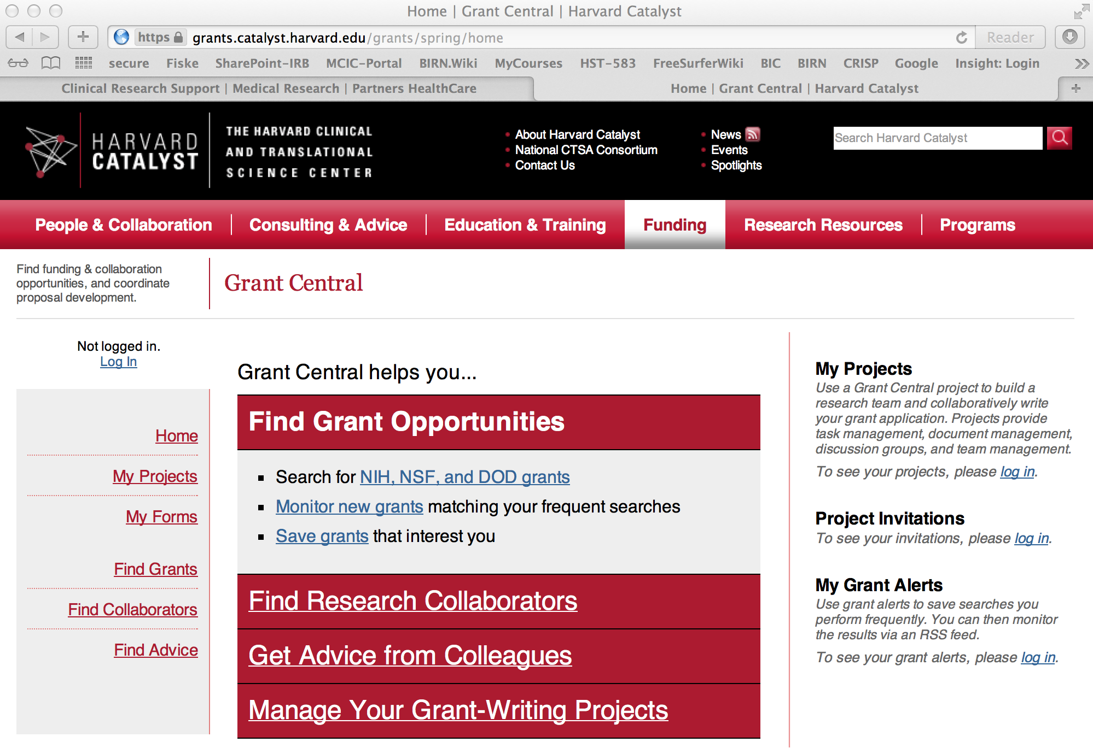
Harvard Catalyst Search Results

Slide 8
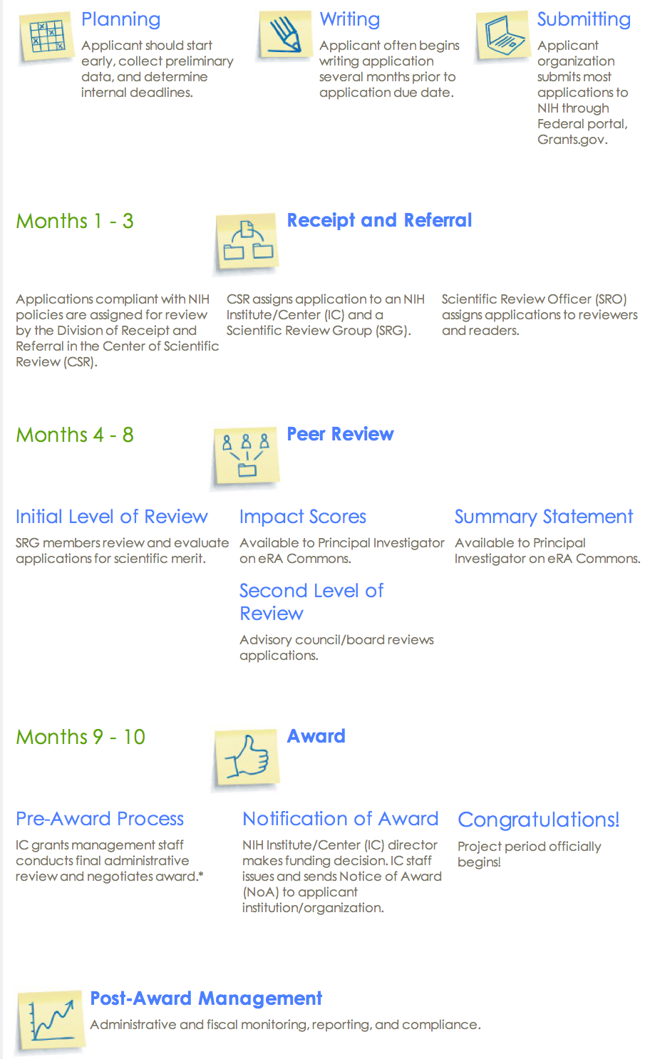
NIH Grants Process Overview- now better than ever!
http://grants.nih.gov/grants/grants_process.htm

Slide 9
NIH Grants
http://grants.nih.gov
There are 27 institutes and centers in the NIH. Funding for a particular grant comes from one of these centers
http://www.nih.gov/icd/
The NIH classifies grants by activity code
Each activity code has different requirements and restrictions
To search for grant codes:http://grants.nih.gov/grants/funding/funding_program.htm
For a detailed listing: http://grants.nih.gov/grants/funding/ac_search_results.htm
Search currently funded grants with the NIH Reporter
http://projectreporter.nih.gov/reporter.cfm

Slide 10
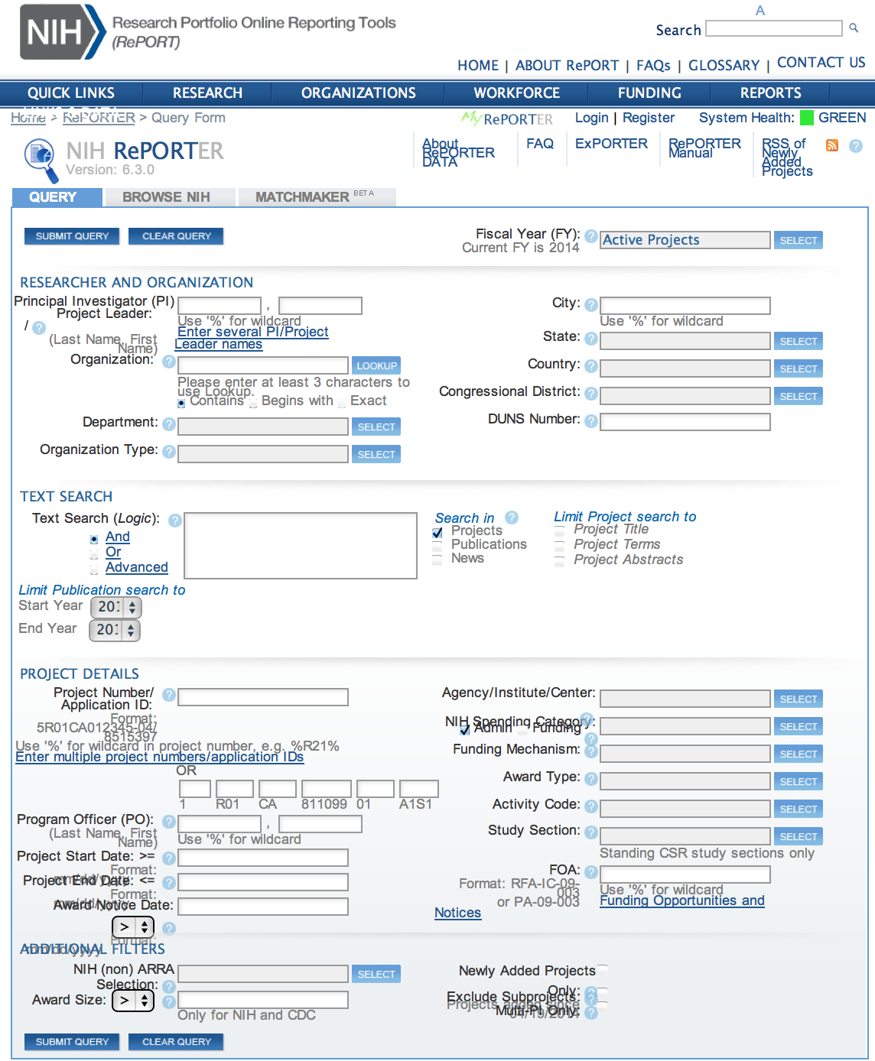
NIH Reporter Search Page
Find out what has been funded in your area of interest
Search Term(s)
Go Live here……

Slide 11
NIH Reporter Results Page

Slide 12
Timeline of NIH Grants
Application timeline:
http://grants.nih.gov/grants/dates.htm
Peer review at NIH:
http://grants.nih.gov/grants/peer/peer.htm
Scoring:
http://grants.nih.gov/grants/peer/guidelines_general/scoring_system_and_procedure.pdf

Slide 13
Summary of Select Activity Codes
F32: NIH Training Grant (Individual Postdoctoral Fellowship)
Pays only post-doc salary (does not cover research costs)
These are judged based on the merit of the post-doc applying and the quality of the mentor’s data
T32: Institutional Research Training Grant
An award given to an institution to fund postdoctoral research. Post-docs would apply for these through their institution not through the NIH
K awards support the transition to an independent investigator
Different K awards are for different types of people. Some are for MDs, others for PhDs. Some are for clinical research and others for basic science. Each type of K award has its own rules.
K awards judge the “man” (the potential of the person applying to be a good scientist), the “plan” (for research and education conducted during the grant period), and the “fan” (the mentor(s))
Most K awards require that you be a US citizen or hold a faculty-track position
K99: The only K award available to non-US citizen post-docs
R21 vs R01: Depends on the project and the outlook of the review committee
R21: 2 years of funding, for smaller exploratory projects, require less money than R01s, require less preliminary data, must hold feasibility
R01: Major projects, must have a high chance of success

Slide 14
RFA vs PA vs FOA
RFA (Request for Application):
Invitations for applications in a well-defined scientific area to accomplish specific program objectives
The score threshold needed to receive funding for an RFA may be lower for these applications
For a list of current RFAs:http://grants.nih.gov/grants/guide/search_results.htm?year=active&scope=rfa
PA (Program Announcement):
Identifies areas of increased priority and/or emphasis on particular funding mechanisms for a specific area of science
http://grants.nih.gov/grants/guide/search_results.htm?year=active&scope=pa
FOA (Funding Opportunity Announcement) or Parent Announcement:
A Parent Announcement encompasses applications that do not fit into either of the above categories
NIH and other HHS Agencies have developed omnibus Parent Announcements for use by applicants who wish to submit what were formerly termed “unsolicited” applications
http://grants.nih.gov/grants/guide/parent_announcements.htm

Slide 15
Know the Rules
Always read the rules
Once you have selected an award mechanism, read the RFA, PA or FOA thoroughly.
Announcements include:
General information common across most announcements
Unique and important information spread throughout the announcement
Eligibility information, important dates, how long the funding period is, and budget requirements
Search for current funding announcements:
http://grants.nih.gov/grants/guide/index.html

Slide 16
NIH Institutes
Each institute has different people on staff and different internal politics
It’s a good idea to get to know the institute, its politics and its people. Get the people there to know you too
In your letter of intent/cover letter, you should direct your grant to 1-2 specific institutes for funding.
This benefits you and the NIH. The NIH staff does not need to figure out where to send your grant, and you are more likely to have your grant sent to the right places
Each institute has its own budget for funding grants

Slide 17
SROs and POs
SRO (Scientific Review Officer):
Manages your grant application through the review process.
PO (Program Officer):
Manages funded grants.
Before submitting a grant application, talk to the POs and SROs
Questions about whether or not a project is fundable and worth submitting are best left to your mentors.
SROs and POs can help you determine if a project is applicable to their funding agency and/or the most appropriate study section for your application
You can contact several different POs and SROs from different institutes. Some people will be more helpful than others. However, the staff at NIH is small and there are a limited number of people to speak with.
It is the job of SROs and POs to help you. Feel free to contact them about most questions you may have.
Many SROs and POs are helpful and want you to succeed. You can develop a long lasting working relationship with these people. For this reason, it is best to be friendly and nice when speaking with the SROs and POs.
When you have chosen a RFA or PA, check the funding announcement to get a list of contacts
NIH institutes will often set up booths at many national meetings and hold grant-writing workshops

Slide 18
Review Process – Study Sections
Center for Scientific Review (CSR) or one of the other IC Review groups
Organizes peer review groups and study sections to evaluate grants
http://cms.csr.nih.gov/
Once submitted to NIH, grants are assigned to a study section
Study sections are made up of individuals with expertise in a particular field/scientific domain
Standing study section:
Review most investigator-initiated applications (both permanent and temporary members)
Special emphasis panel:
Review applications on specific topics (only temporary members)
Request a particular study section if the roster includes people with pertinent expertise
If a study section does not contain members with the appropriate expertise to review your application you can work with the SRO to request and recommend an additional reviewer
Notes:
grant application is assigned for review to the CSR or to one of the other IC Review groups. CSR reviews most R01s, fellowships, and small business applications. IC review groups handle applications that have Institute-specific features such as program projects, training grants, career development awards, and responses to Requests for Applications.

Slide 19
Review Process
SROs and POs sit in on the review process. They can help clarify some of the issues raised by the review panel

Slide 20
Grant Applications and Forms
Most competing grant applications to NIH require electronic submission.
http://grants.nih.gov/grants/submitapplication.htm
Organizations (MGH, BWH, etc.) submit applications via www.grants.gov, an online portal, on your behalf to all Federal agencies.
Applicants (PIs) must follow their application through eRA Commons, NIH’s electronic system for grants administration, to complete the submission process.
https://public.era.nih.gov/commons
eRA Commons is also used to track funded grants

Slide 21
Submitting A Proposal (NIH)
Check the grant announcement for specifics regarding dates and deadlines
NIH Deadlines:
http://grants1.nih.gov/grants/funding/submissionschedule.htm
Register for grants.gov and eRA Commons early!
Submit early!
Always download new forms/templates for each grant submission as forms change often
http://grants.nih.gov/grants/forms.htm

Slide 22
Submitting A Proposal (Partners)
Partners Research Management:
http://resadmin.partners.org/RM_Home/default.aspx/
Partners requires internal forms
Forms: https://resadmin.partners.org/RM_Home/Forms/Lifecycle/FTR-FormsLife.aspx
Checklists: https://resadmin.partners.org/RM_Home/Forms/Tools_Resources/Checklists/FTR-ToolsChecklists.aspx
Partners requires internal review of all NIH grants before NIH Submission.
Deadlines:
All proposals will be developed, submitted, and tracked online using InfoED (link works upon login)
https://infoed.partners.org/Partners_login/login.asp?CTAuthMode=BASIC

Slide 23
Letter of Intent/Cover Letter
Some grant announcements request a letter of intent, whereas others do not
A formal letter of intent or cover letter includes:
Funding announcement you are replying to
Institutes you would like to send your application to
Review panels you think would be most appropriate for your project
Sending your grant to the right place can also increase your success in the review process
You may consider calling ahead to the SRO to let them know you are submitting a grant application

Slide 24
Budget Writing
Check the rules of the grant announcement to find budget restrictions. This includes the budget limits and whether a modular budget is allowed
Use InfoED (where available) or the budget template on the Partners Research Management website.
Request the appropriate amount of money to conduct your research properly and honestly. This includes a consideration of cohort size, outcome measures, and power.
http://grants.nih.gov/grants/developing_budget.htm

Slide 25
Modular Budget vs Detailed Budget
Modular budget:
Lump sums of $25,000 intervals
Must include: personal justification, consortium justification (where applicable), additional narrative justification
http://grants.nih.gov/grants/developing_budget.htm#modbud
Detailed budget:
Includes: personnel (new salary cap; http://grants.nih.gov/grants/policy/fy2012_salary_cap_faqs.htm), equipment, travel, trainees, materials and supplies, animals, publications, consultants, computer, alterations, patient care, tuition, and other costs
http://grants.nih.gov/grants/developing_budget.htm#personnel
Cost of living adjustments no longer allowed! Get your promotion/salary negotiation done in advance.
http://grants.nih.gov/grants/guide/notice-files/not-od-12-036.html

Slide 26
Budget (continued)
Having a budget planned out is essential to conduct honest research
A full budget is required for Just-In-Time (JIT) submissions, which are requested if your project received a good score at review and is likely to be funded
For some categories (ex. office supplies) it is fine to put a rough estimate of the amount of money you need on the application
Get help from the grants or sponsored programs office within your own institution, your departmental administrative officials, and your peers
Things to take into consideration:
Indirect (F&A) vs. direct costs
Salaries
Fringe benefit rates
Departmental fees
IT support (Martinos &/or your parent institution)

Slide 27
Indirect Costs (F&A)
Remember to consider indirect rates in your budget
Each Partners entity negotiates a multi-year agreement of predetermined F&A rates with DHHS every 3-4 years.
Partners charges indirects on all grants
Indirects are used to fund institutional resources
Current Partners Agreement (May 6, 2011)
http://resadmin.partners.org/RM_Home/Proposals/Proposal_Prep/Costs/PropCosts.aspx
Current Indirect rate = 74% (FY2013)
Complex, read the full policy

Slide 28
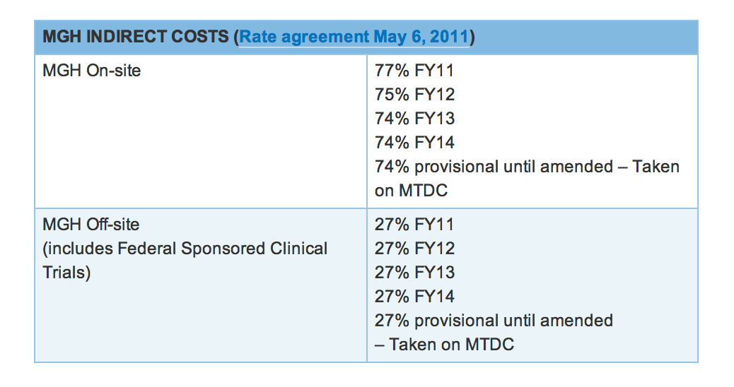

Slide 29
Salaries and Percent Effort
Salary ranges are dependent on official title and years of experience
Discuss your salary with your mentor
Raises can be requested at the departmental level upon success with grant submissions
Special permission is required for raises >6%
The Center for Faculty Development provides consultation on professional staff compensation at Partners (see slide 31)
Maximum Percent Effort allowed is 100% / 12 Calendar Months
In the “overlap” section of your Other Support page, it should explain how percent effort will be changed to maintain no more than 100%
Special approval is needed for changes to percent effort of 25% or more
Work with your grant administrator to adjust your support

Slide 30
Fringe Rates and Department Fees
Fringe Benefit Rates:
Approved by federal government for each fiscal year
Cover cost of insurance coverage, retirement, etc.
http://phsresearchintranet.partners.org/RM_Home/Proposals/Proposal_Prep/Costs/PropCosts.aspx
Department fees:
Ex. Martinos Center IT support, research core fees
For more information:
http://phsresearchintranet.partners.org/RM_Home/Proposals/Proposal_Prep/MGH-InstitutionalFacts.aspx
Notes:
Neither of these links is functional, but the fringe benefit rates for Partners can be found on the link listed on Slide 27:http://resadmin.partners.org/RM_Home/Proposals/Proposal_Prep/Costs/PropCosts.aspx

Slide 31
Fringe benefit rates

Slide 32
Career Development
http://www2.massgeneral.org/facultydevelopment/index.html

Slide 33
How Long Will It Take?
Expect to spend 2+ months of hard work to prepare your first NIH type grant
It can take 5-18 months after receipt for an award to be made, up to 28 months if you need to resubmit

Slide 34
What if I don’t get funded?
Resubmissions
You are allowed 1 resubmission of an application seeking funding
Then… Try again, and keep trying!

Slide 35
Questions?
READ THE MATERIAL ON THE LINKS PROVIDED!!!!!
Still got questions:
rgollub@partners.org

