Slide 1





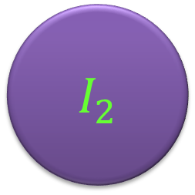
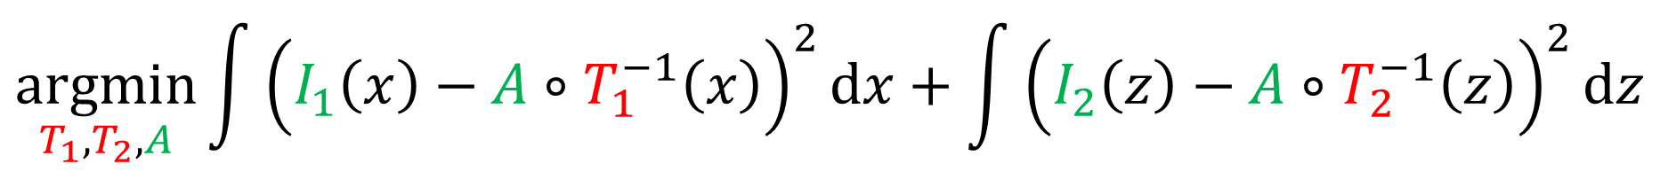

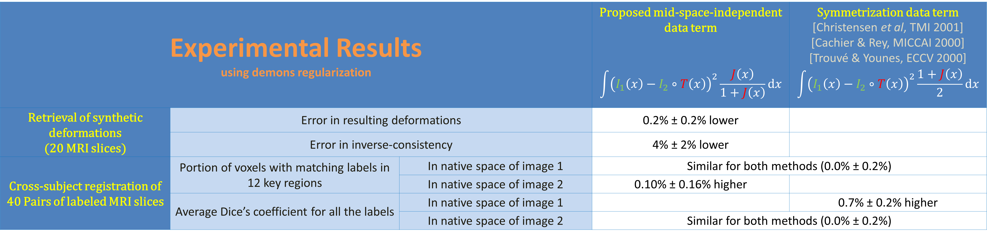
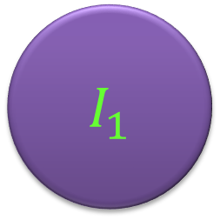
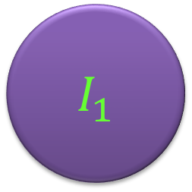


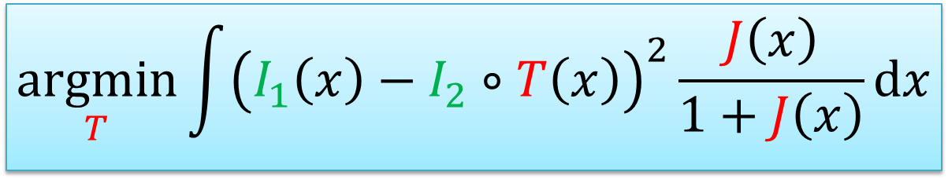
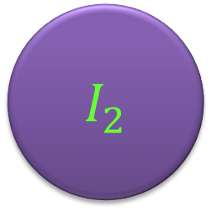
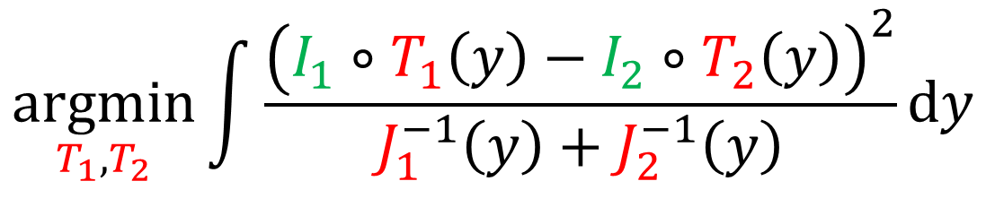

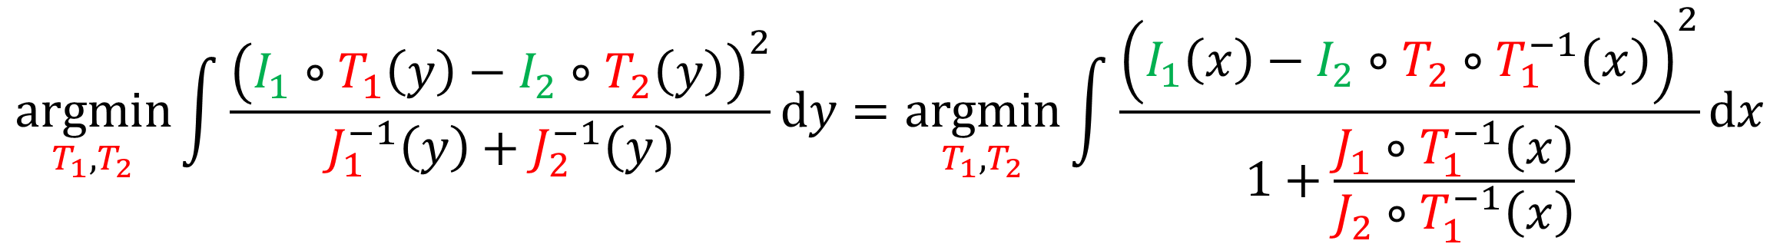
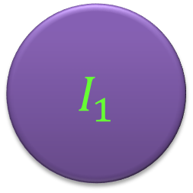




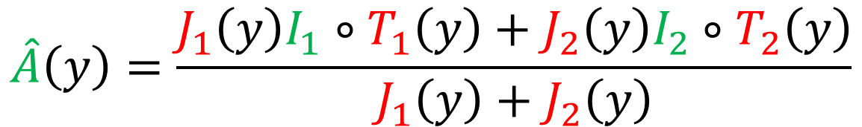

Mid-Space-Independent Symmetric Data Term for Pairwise Deformable Image Registration
Iman Aganj,¹ Eugenio Iglesias,² Martin Reuter,^{1,3} Mert Sabuncu,^{1,3} Bruce Fischl^{1,3}
¹ Athinoula A. Martinos Center for Biomedical Imaging, Massachusetts General Hospital, Harvard Medical School
² Basque Center on Cognition, Brain and Language, San Sebastian, Spain
³ Computer Science and Artificial Intelligence Lab, Massachusetts Institute of Technology
atlas
transformation
$$A$$
Data term for mid-space deformable registration through an atlas
Requires anti-drift constraints
$$T_{1}$$
$$T_{2}$$
$$\underset{T_{1},T_{2},A}{argmin}{\int{{\left(I_{1}\left(x\right)−A∘T_{1}^{−1}\left(x\right)\right)}^{2}dx}+\int{{\left(I_{2}\left(z\right)−A∘T_{2}^{−1}\left(z\right)\right)}^{2}dz}}$$
$$\hat{A}\left(y\right)=\frac{J_{1}\left(y\right)I_{1}∘T_{1}\left(y\right)+J_{2}\left(y\right)I_{2}∘T_{2}\left(y\right)}{J_{1}\left(y\right)+J_{2}\left(y\right)}$$
$$I_{1}$$
$$I_{2}$$
Jacobian
determinant
$$T=T_{2}∘T_{1}^{−1}$$
image
[Ma et al, NeuroImage 2008]
mid-space
$$T_{1}$$
$$T_{2}$$
Implicit-atlas data term
$$\underset{T_{1},T_{2}}{argmin}{\int{\frac{{\left(I_{1}∘T_{1}\left(y\right)−I_{2}∘T_{2}\left(y\right)\right)}^{2}}{J_{1}^{−1}\left(y\right)+J_{2}^{−1}\left(y\right)}dy}}$$
$$I_{1}$$
$$I_{2}$$
[Ashburner & Ridgway, Front Neurosci 2013]
$$T=T_{2}∘T_{1}^{−1}$$
Mid-space-independent data term
No need for anti-drift constraints
$$\underset{T_{1},T_{2}}{argmin}{\int{\frac{{\left(I_{1}∘T_{1}\left(y\right)−I_{2}∘T_{2}\left(y\right)\right)}^{2}}{J_{1}^{−1}\left(y\right)+J_{2}^{−1}\left(y\right)}dy}}=\underset{T_{1},T_{2}}{argmin}{\int{\frac{{\left(I_{1}\left(x\right)−I_{2}∘T_{2}∘T_{1}^{−1}\left(x\right)\right)}^{2}}{1+\frac{J_{1}∘T_{1}^{−1}\left(x\right)}{J_{2}∘T_{1}^{−1}\left(x\right)}}dx}}$$
$$I_{1}$$
$$I_{2}$$
$$T$$
$$\underset{T}{argmin}{\int{{\left(I_{1}\left(x\right)−I_{2}∘T\left(x\right)\right)}^{2}\frac{J\left(x\right)}{1+J\left(x\right)}dx}}$$
[proposed data term]
Experimental Results using demons regularization |  |  | Proposed mid-space-independent data term $$\int{{\left(I_{1}\left(x\right)−I_{2}∘T\left(x\right)\right)}^{2}\frac{J\left(x\right)}{1+J\left(x\right)}dx}$$ | Symmetrization data term [Christensen et al, TMI 2001] [Cachier & Rey, MICCAI 2000] [Trouvé & Younes, ECCV 2000] $$\int{{\left(I_{1}\left(x\right)−I_{2}∘T\left(x\right)\right)}^{2}\frac{1+J\left(x\right)}{2}dx}$$
Retrieval of synthetic deformations (20 MRI slices) | Error in resulting deformations |  | 0.2% ± 0.2% lower
 | Error in inverse-consistency |  | 4% ± 2% lower
Cross-subject registration of 40 Pairs of labeled MRI slices | Portion of voxels with matching labels in 12 key regions | In native space of image 1 | Similar for both methods (0.0% ± 0.2%)
 |  | In native space of image 2 | 0.10% ± 0.16% higher
 | Average Dice’s coefficient for all the labels | In native space of image 1 |  | 0.7% ± 0.2% higher
 |  | In native space of image 2 | Similar for both methods (0.0% ± 0.2%)
Retrieval of synthetic deformations
The original image (a) was deformed by two synthetic random transformations (b,c). The deformed images were then registered with each other, resulting in de-formation fields by the proposed (d) and the symmetrization (e) methods.
Cross-subject registration of
labeled MRI slices
Examples of the labeled coronal slices used in the experiments.
Acknowledgments: Project supported by:
The National Institutes of Health, Massachusetts Alzheimer’s Disease Research Center, BrightFocus Foundation, Ellison Medical Foundation, and Gipuzkoako Foru Aldundia.

