Slide 1
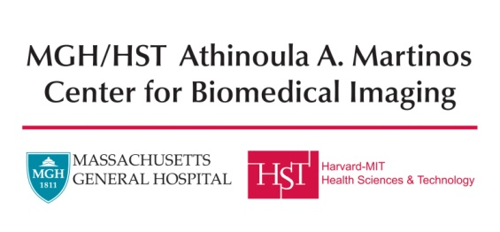


Four Decades of Automated Image Registration and Segmentation
Koen Van Leemput
April 7, 2022
DSMF symposium - Middelfart

Slide 2
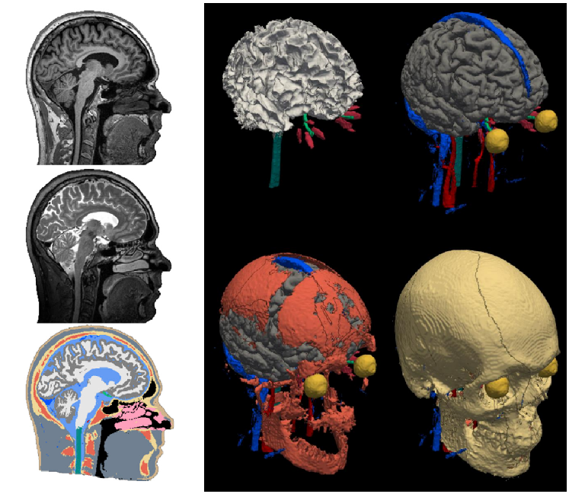
Automatic segmentation
  Compared to manual delineations:
    Much faster
    More structures
    More repeatable
MRI
segmentation

Slide 3
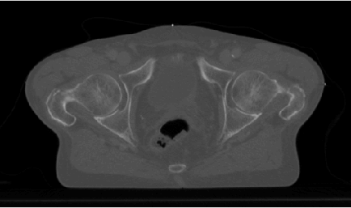
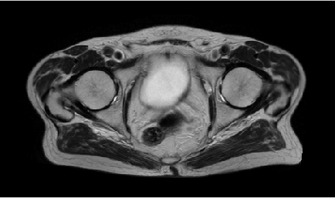
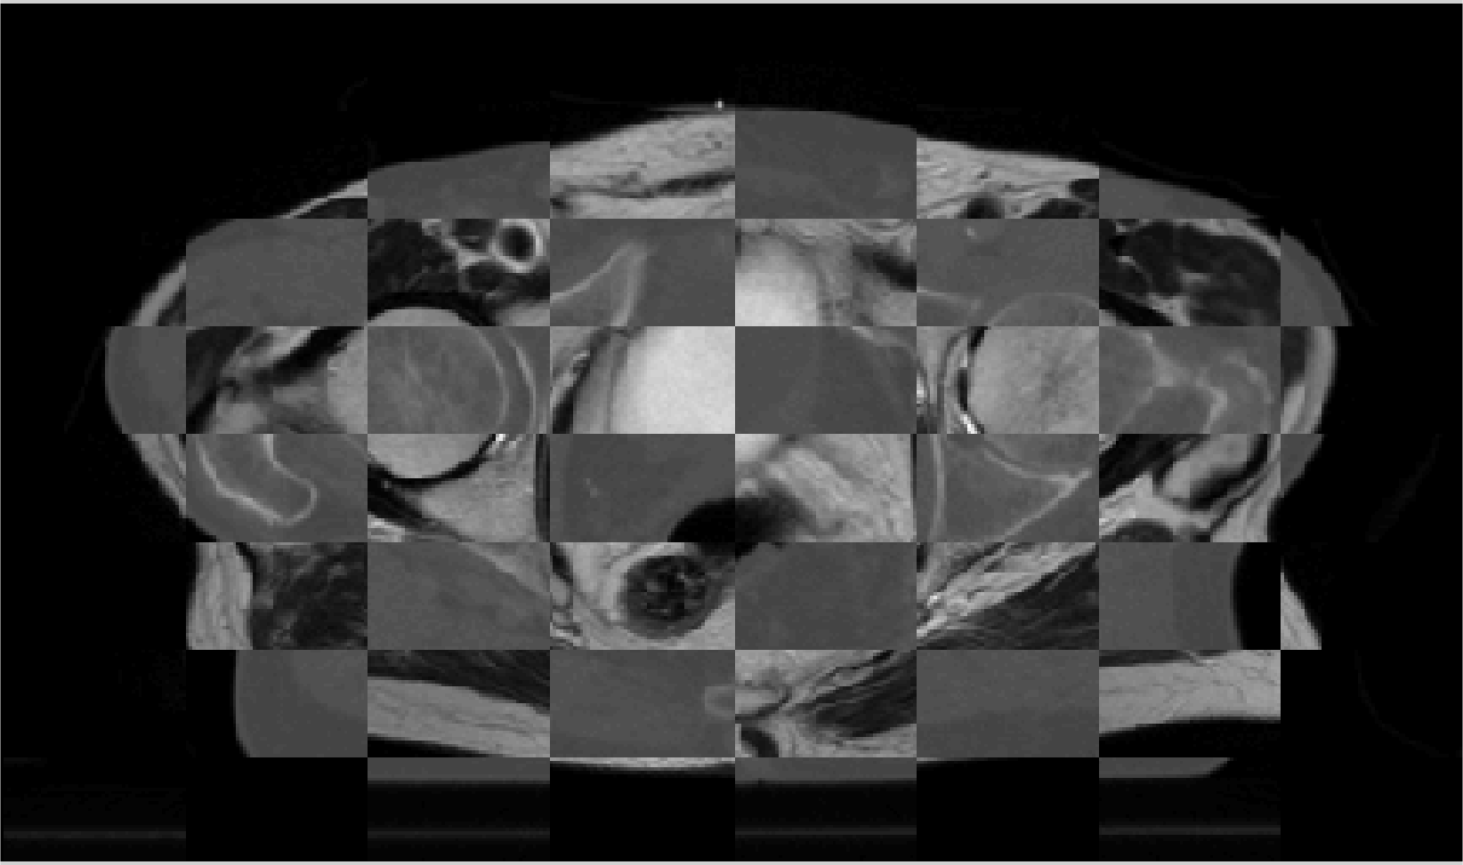
Automatic registration
CT
  Local expansion/compression of tissue:
    patient positioning
    bowel/bladder/… filling
    tumor shrinkage
    patient weight loss
    …
MRI
mosaic

Slide 4
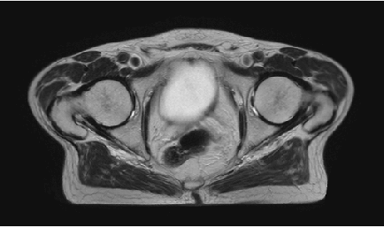
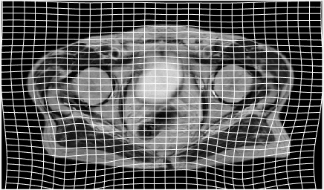
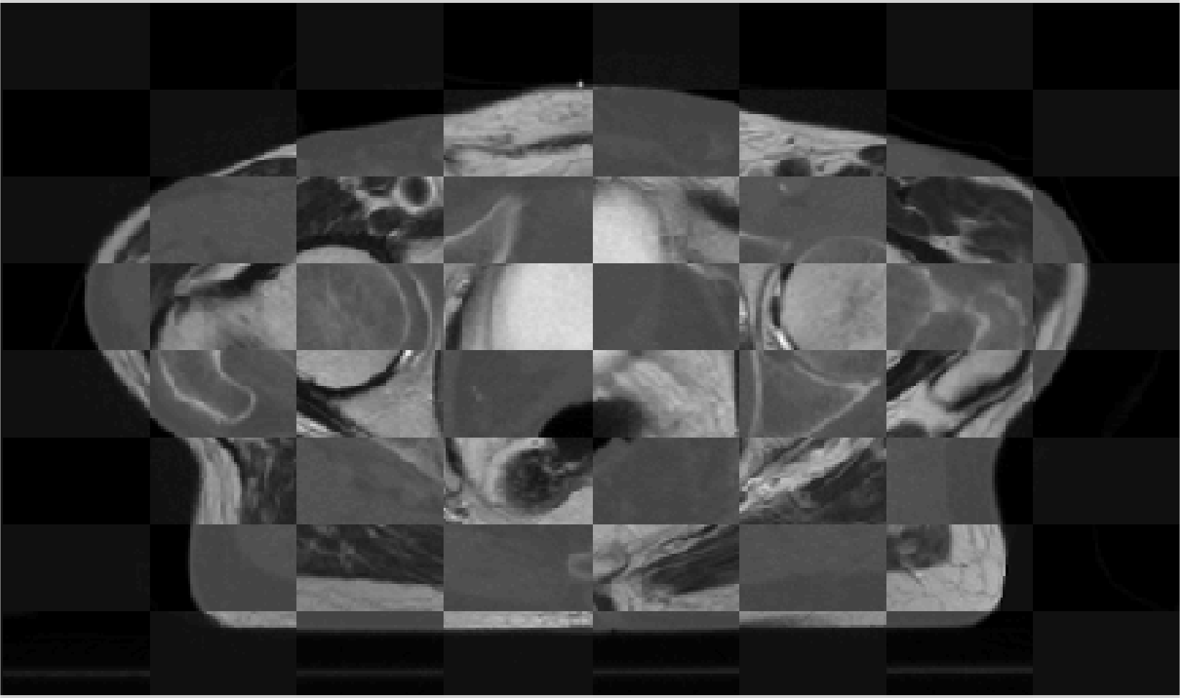
Automatic registration
CT
  Local expansion/compression of tissue:
    patient positioning
    bowel/bladder/… filling
    tumor shrinkage
    patient weight loss
    …
deformed MRI
deformation
mosaic

Slide 5

Four decades
  1981-2000:
  1996-now: yours truly
    professor at DTU Health Tech
    also affiliated with Massachusetts General Hospital
    highly subjective and biased!

Slide 6
Overview
Pre-1980 to 1994: humble beginnings
1995-2014: model-based techniques:
  Unimodal deformable registration
  Multimodal registration
  Statistical shape models
  Segmentation using generative models
  Hyped-up topics
2015-now: learning from examples
Future outlook

Slide 7
Overview
Pre-1980 to 1994: humble beginnings
1995-2014: model-based techniques:
  Unimodal deformable registration
  Multimodal registration
  Statistical shape models
  Segmentation using generative models
  Hyped-up topics
2015-now: learning from examples
Future outlook

Slide 8
Pre-1980 to 1984
  Analyzing two-dimensional (2D) images
  Low-level image processing:
    “bottom-up” approach
    e.g., region growing, edge detection, …

Slide 9
1985-1994: Early days
  3D processing
    Magnetic resonance imaging (MRI)
    Initially 7-10mm slice thickness/spacing…
    Later at higher spatial resolution
    Also 3D PET, SPECT, ultrasound, fast spiral-CT, …

Slide 10
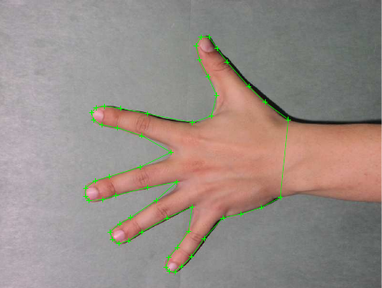
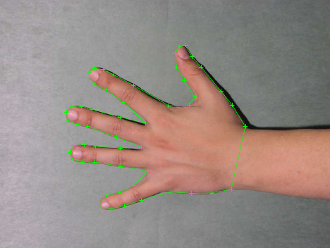

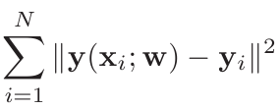

Registration by aligning corresponding points
x₁
y₁
  XXXX
    XXX
rigid: translation + rotation
y₂
x₂
image 1
image 2
Match two corresponding point sets defined in two images:

Slide 11
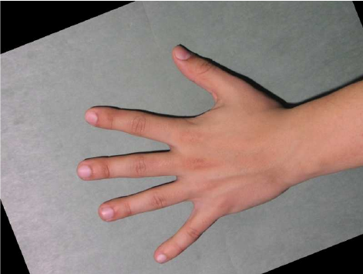
Registration by aligning corresponding points
x₁
y₁
  XXXX
    XXX
y₂
x₂
image 1
image 2
registered image 2
Match two corresponding point sets defined in two images:

Slide 12
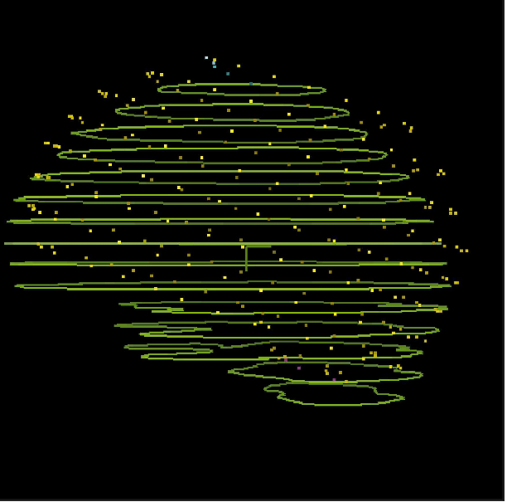
Multimodal registration-by-segmentation (1989)
  Manually annotate brain surface:
    contours = MRI
    dots = PET
[Pelizarri JCAT 1989]

Slide 13
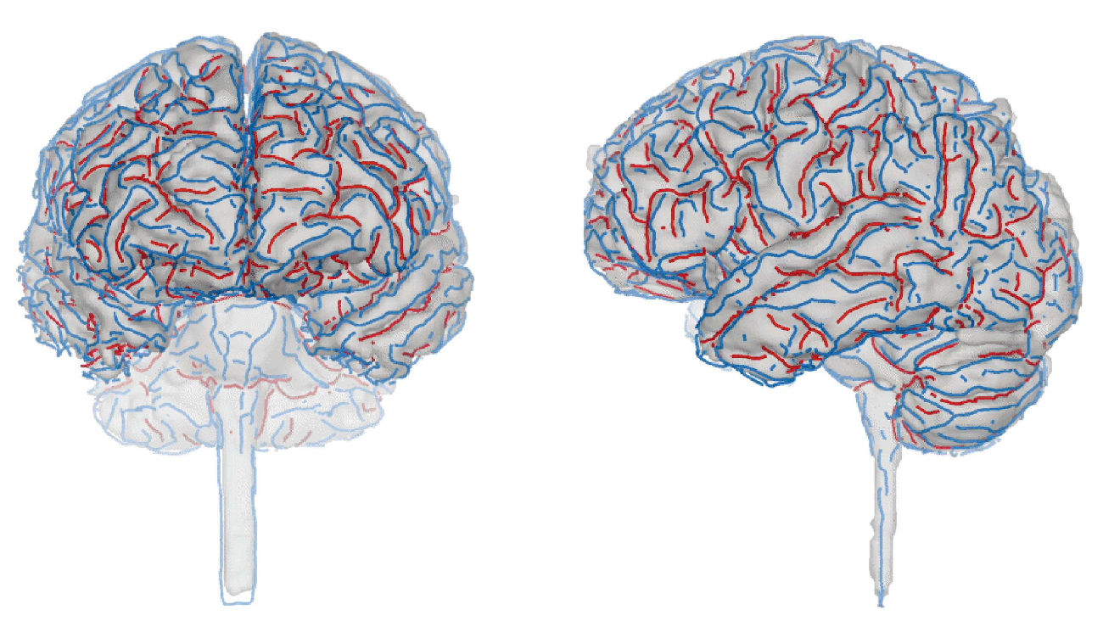
Inter-subject registration-by-segmentation (1993)
  Somehow segment brain surface:
    automatically extract “interesting” lines
    try to match lines across brains
[Thirion RR 1993]

Slide 14
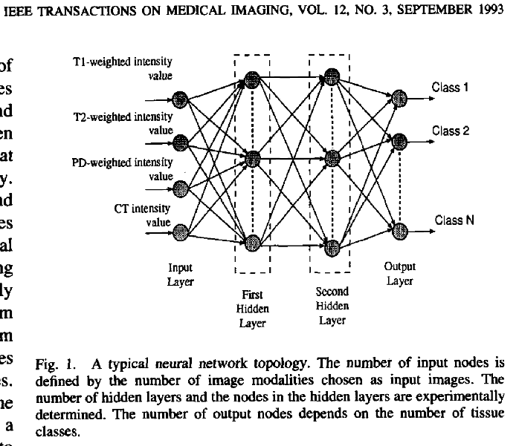
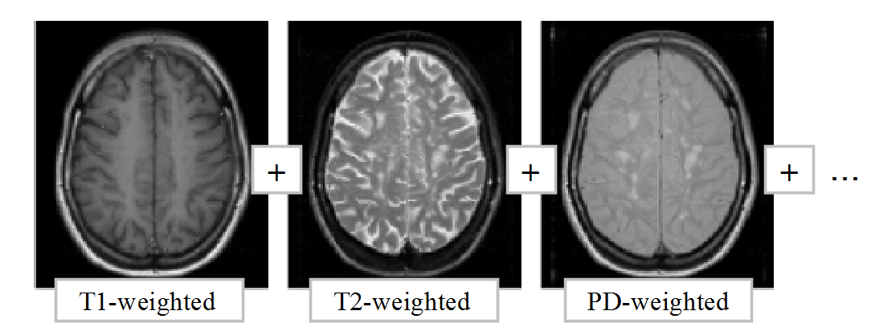
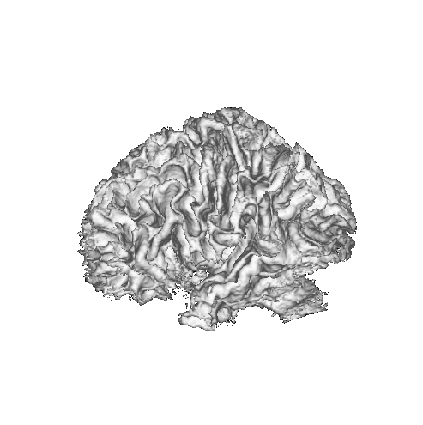
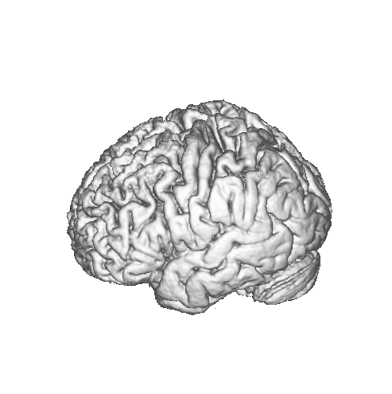
Tissue classification with a neural network (1993)

Slide 15
Overview
Pre-1980 to 1994: humble beginnings
1995-2014: model-based techniques:
  Unimodal deformable registration
  Multimodal registration
  Statistical shape models
  Segmentation using generative models
  Hyped-up topics
2015-now: learning from examples
Future outlook

Slide 16
1995-2014: Model-based methods
  Models:
    “top-down” instead of “bottom-up”
    prior domain knowledge

Slide 17
Overview
Pre-1980 to 1994: humble beginnings
1995-2014: model-based techniques:
  Unimodal deformable registration
  Multimodal registration
  Statistical shape models
  Segmentation using generative models
  Hyped-up topics
2015-now: learning from examples
Future outlook

Slide 18
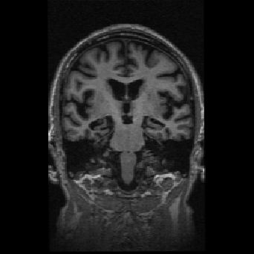
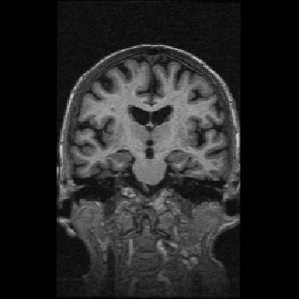
Unimodal deformable registration
subject 1
subject 2

Slide 19
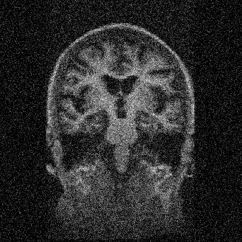
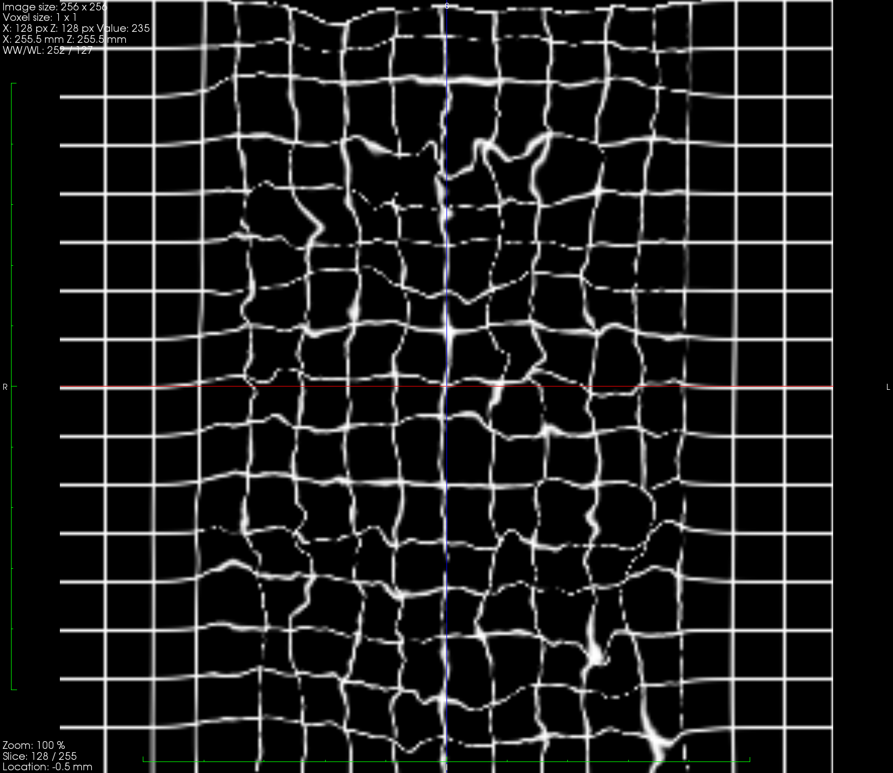
Unimodal deformable registration: generative model
random warp and noise
≈
subject 2
deformed and noisy subject 2
subject 1
random warp:
- initially fluid mechanics
- later just smoothness

Slide 20
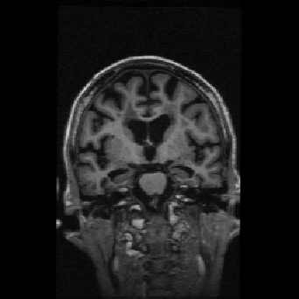
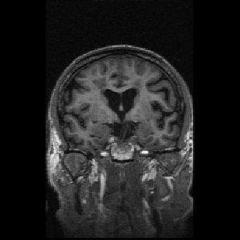
Unimodal deformable registration
  Fast filter-based solvers [Thirion MEDIA 1998]
subject 1
subject 2
...
subject N

Slide 21
Unimodal deformable registration
  Fast filter-based solvers [Thirion MEDIA 1998]
subject 1
subject 2
...
subject N

Slide 22
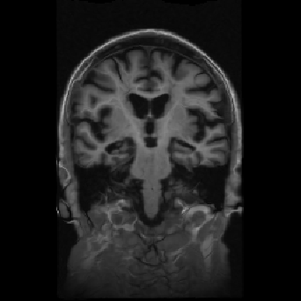
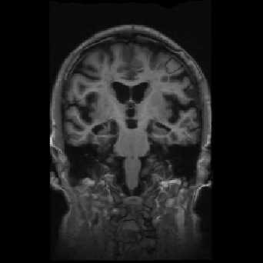
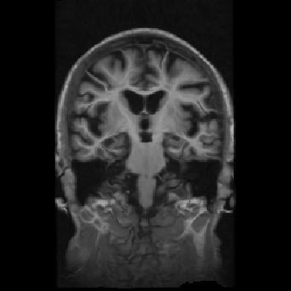
Unimodal deformable registration
  Fast filter-based solvers [Thirion MEDIA 1998]
subject 1
subject 2
...
subject N

Slide 23
Overview
Pre-1980 to 1994: humble beginnings
1995-2014: model-based techniques:
  Unimodal deformable registration
  Multimodal registration
  Statistical shape models
  Segmentation using generative models
  Hyped-up topics
2015-now: learning from examples
Future outlook

Slide 24
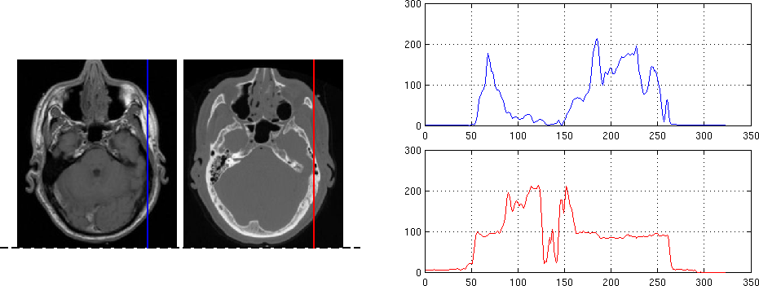

Multimodal registration
“good”

Slide 25
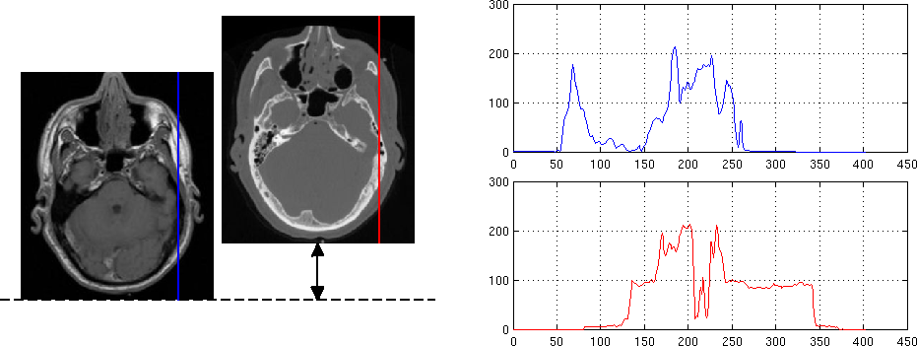

Multimodal registration
“bad”

Slide 26
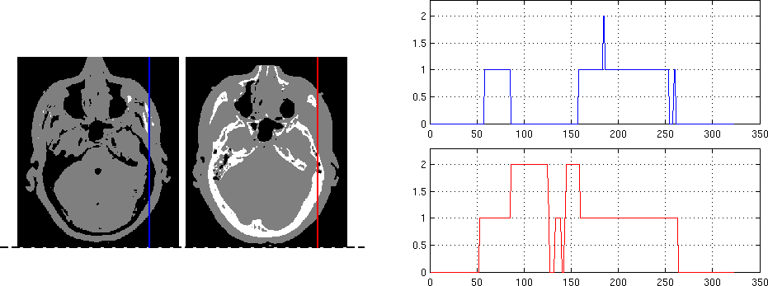
Multimodal registration
  With discretized intensities (toy example)
“good”

Slide 27
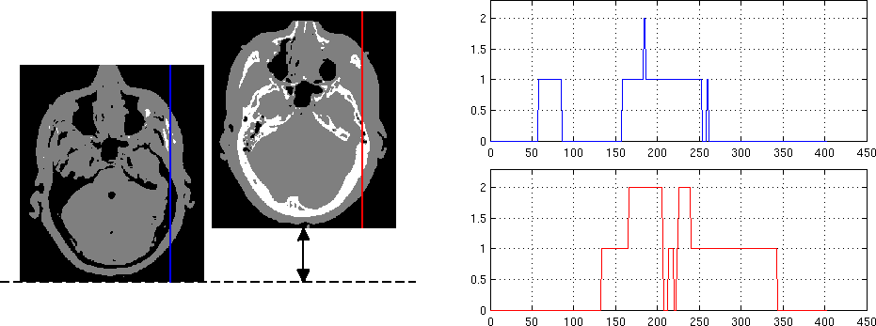
Multimodal registration
  With discretized intensities (toy example)
“bad”

Slide 28
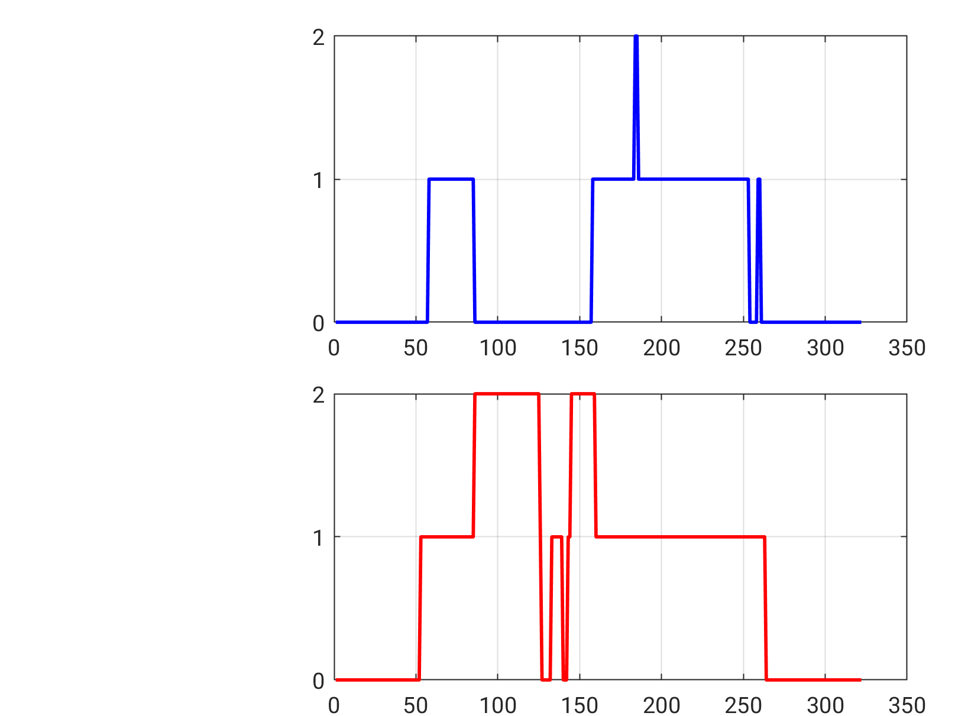
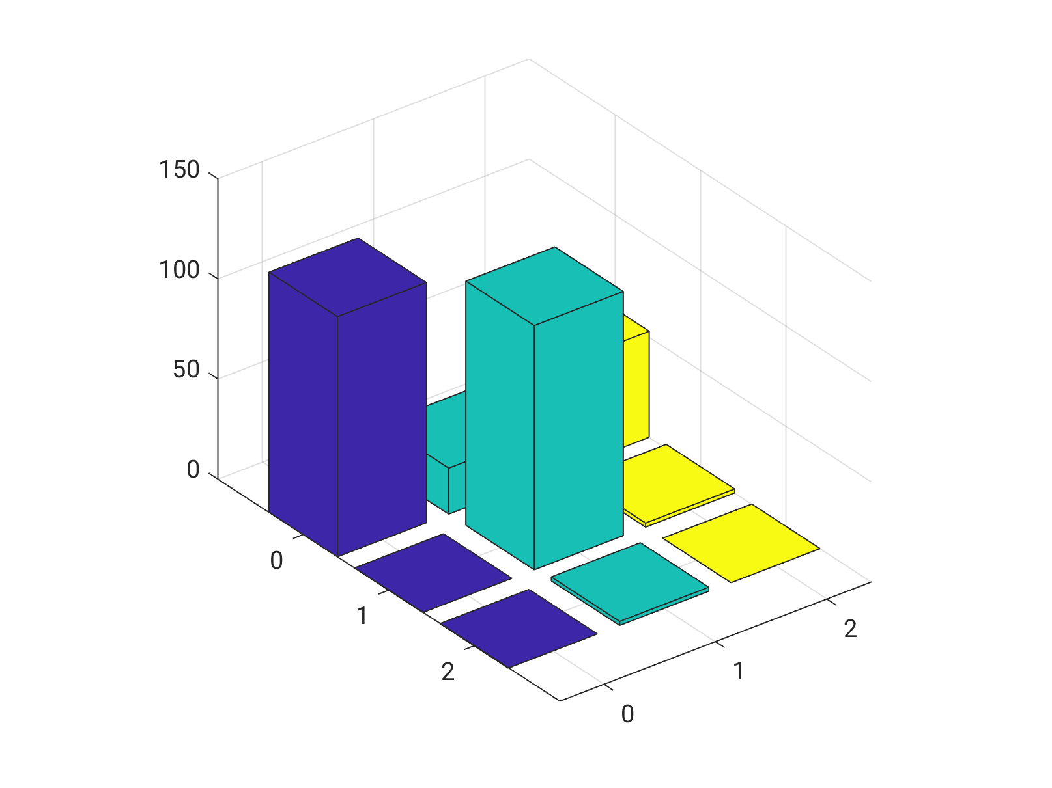
Multimodal registration
  Idea: build a joint histogram
MRI
“good”
CT
MRI
CT

Slide 29
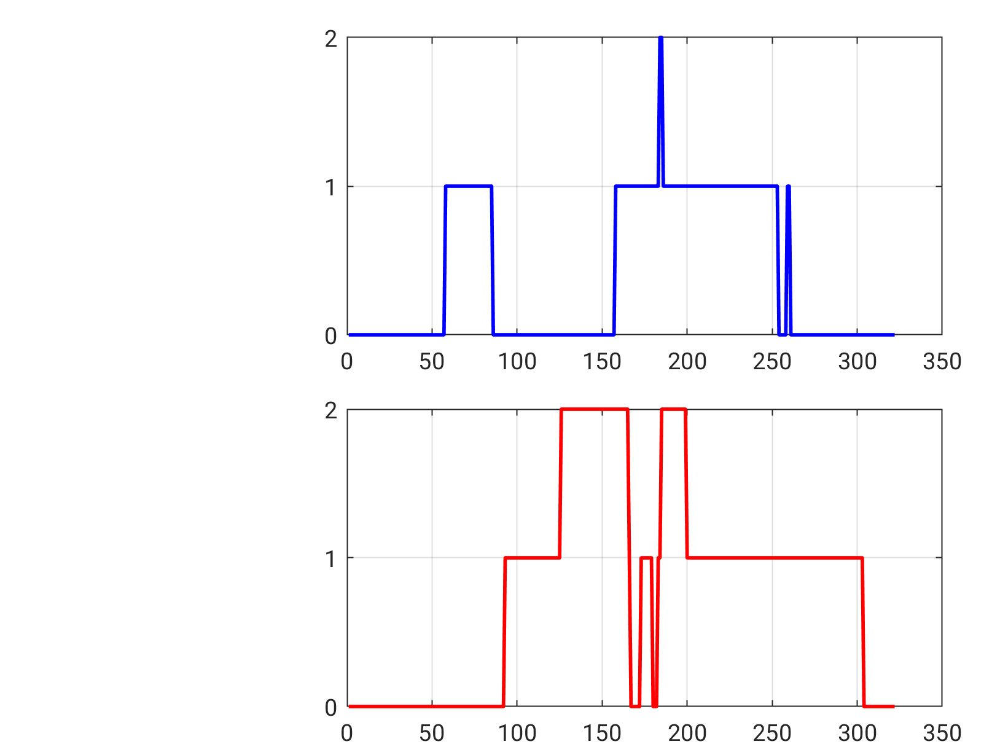
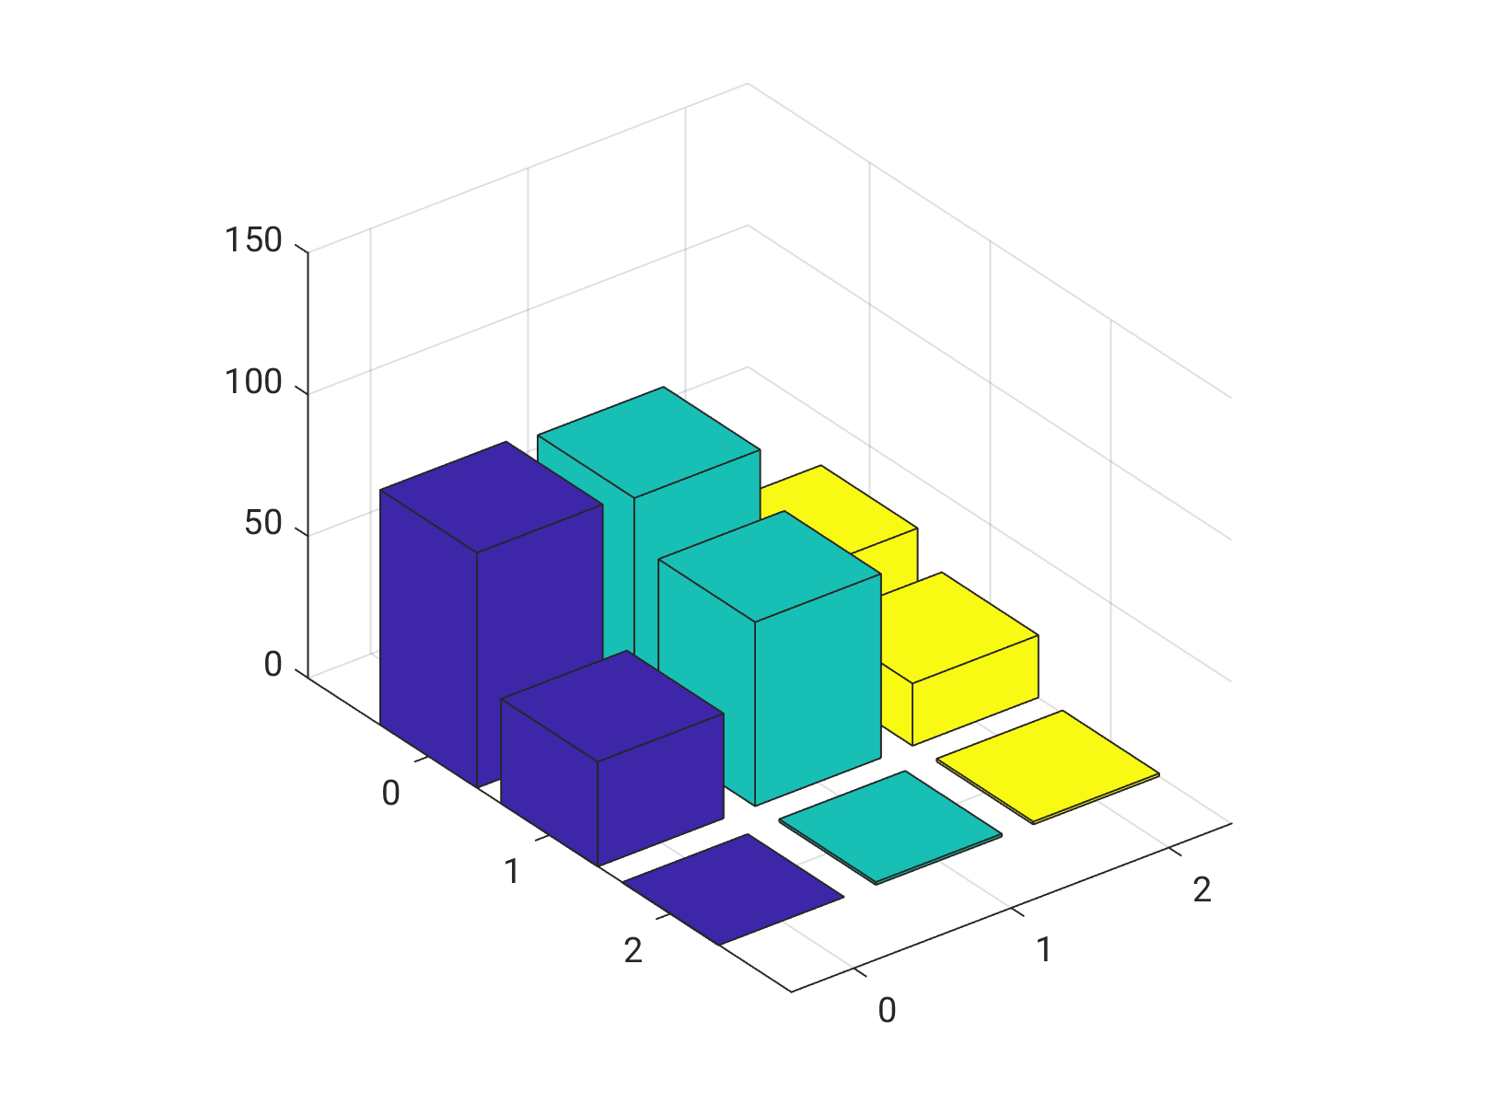
Multimodal registration
  Idea: build a joint histogram
MRI
“bad”
CT
MRI
CT

Slide 30
Multimodal registration
  Idea: compute joint entropy
MRI
MRI
CT
CT
lower entropy
higher entropy

Slide 31
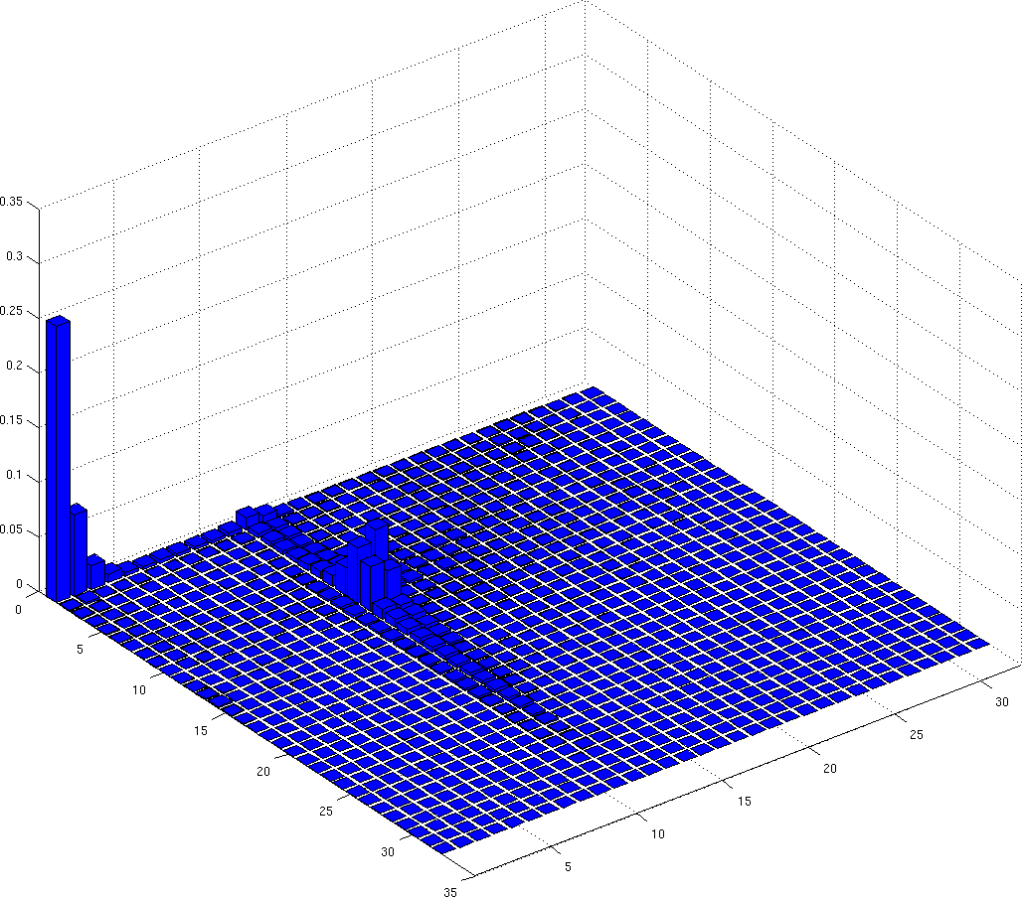
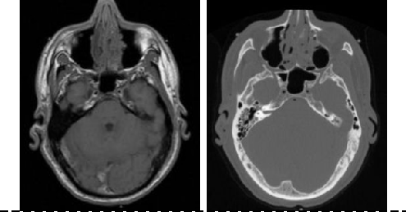
Multimodal registration
CT intensities
“good” = low entropy
MR intensities
[Maes TMI 1997]
[Wells MEDIA 1996]

Slide 32
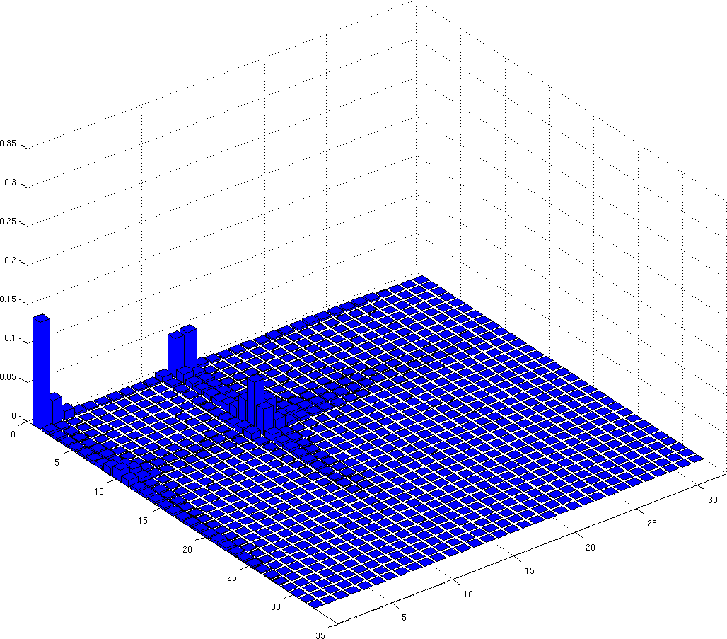
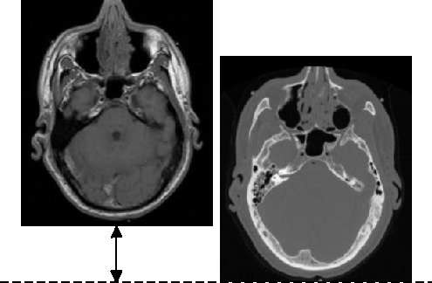
Multimodal registration
CT intensities
“bad” = high entropy
MR intensities
[Maes TMI 1997]
[Wells MEDIA 1996]

Slide 33
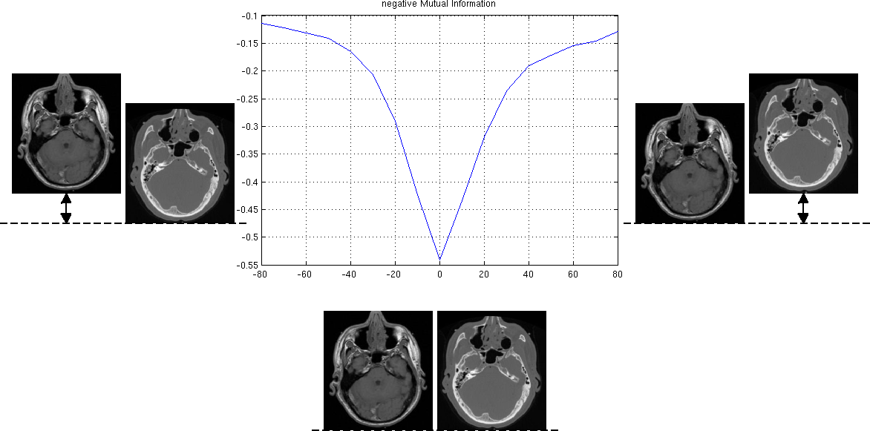
Multimodal registration
numerical optimization of entropy

Slide 34
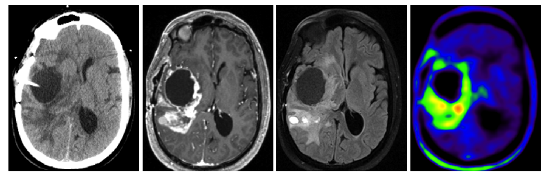
Multimodal registration
    Modality?
    Scanner?
    Manufacturer?
    Acquisition protocol?
  It doesn’t matter!!

Slide 35
Overview
Pre-1980 to 1994: humble beginnings
1995-2014: model-based techniques:
  Unimodal deformable registration
  Multimodal registration
  Statistical shape models
  Segmentation using generative models
  Hyped-up topics
2015-now: learning from examples
Future outlook

Slide 36
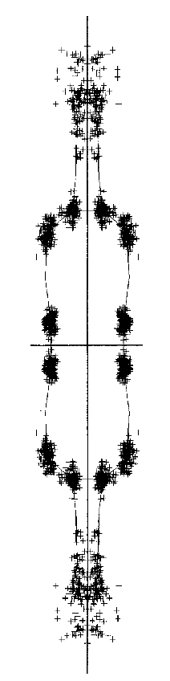
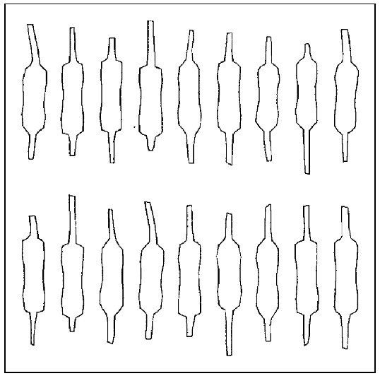
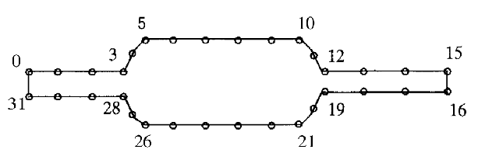
Statistical shape models
  Modeling the shape of resistors: 32 corresponding points
“training data”
[Cootes CVIU 1995]

Slide 37
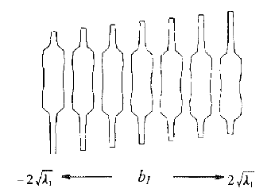
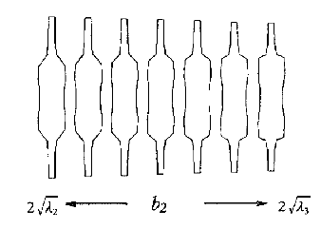
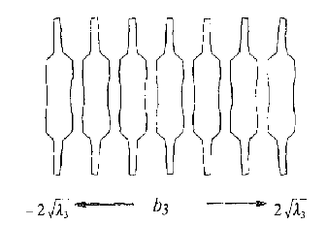
Statistical shape models
  32*2 = 64-dimensional feature vector
  mean shape
  principal components:
    major modes of variation
    eigenvectors of covariance matrix

Slide 38
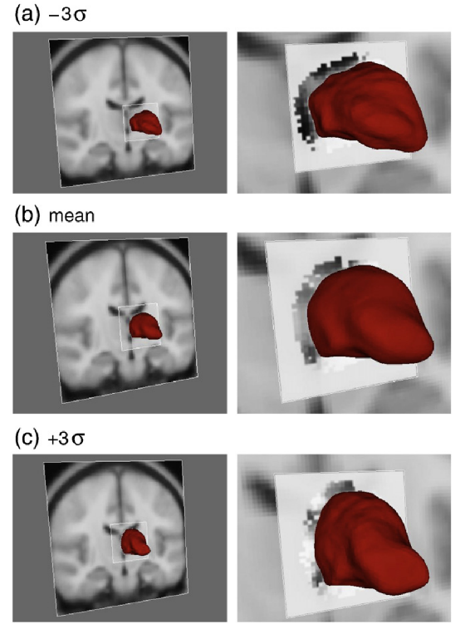
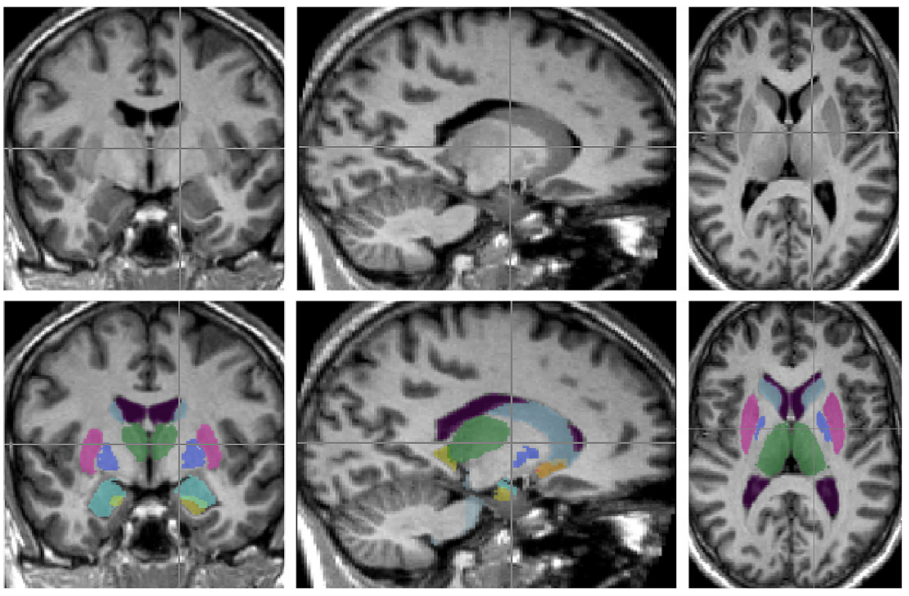
Application in brain segmentation
[Patenaude NeuroImage 2011]

Slide 39
Overview
Pre-1980 to 1994: humble beginnings
1995-2014: model-based techniques:
  Unimodal deformable registration
  Multimodal registration
  Statistical shape models
  Segmentation using generative models
  Hyped-up topics
2015-now: learning from examples
Future outlook

Slide 40
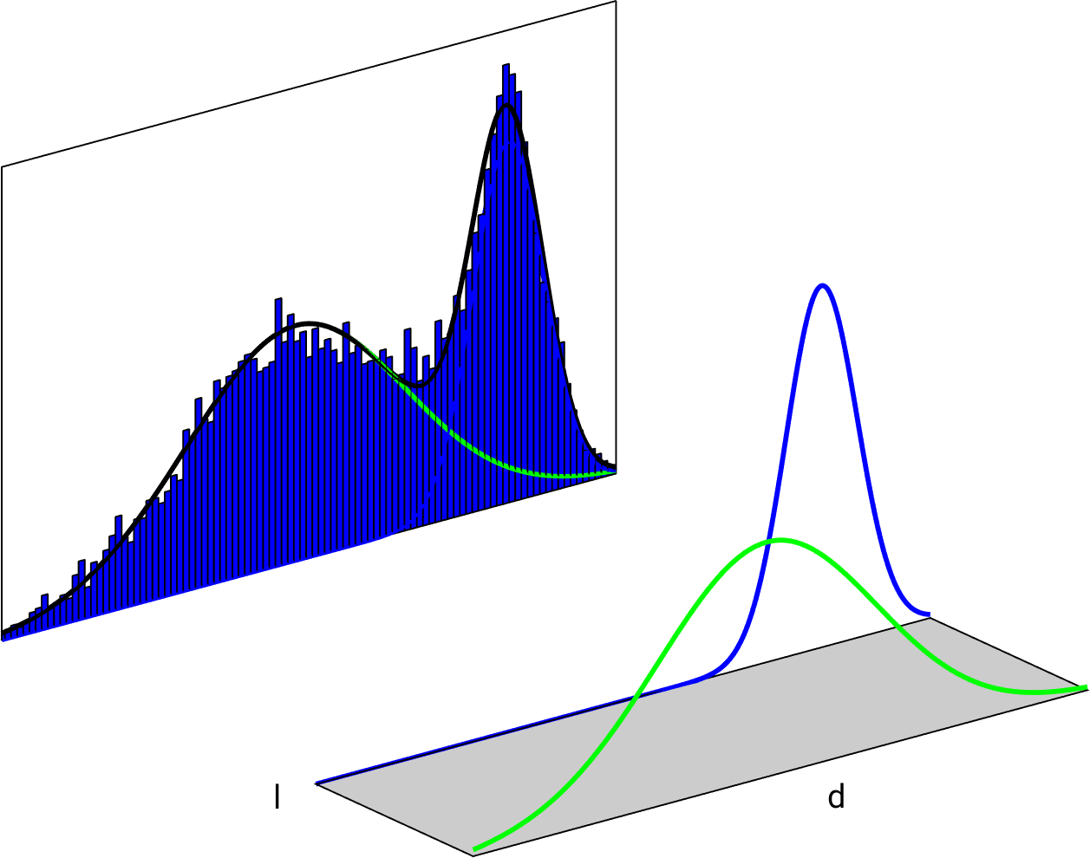

Gaussian mixture models
  Voxel-wise segmentation
  Build a cartoon model of the world:
segmentation label:
- “1” for white matter
- “0” for gray matter
intensity

Slide 41
Gaussian mixture models
  Voxel-wise segmentation
  Build a cartoon model of the world:
segmentation label:
- “1” for white matter
- “0” for gray matter
intensity
model parameters

Slide 42


Gaussian mixture models

Slide 43

Gaussian mixture models

Slide 44


Gaussian mixture models

Slide 45

Gaussian mixture models

Slide 46


Gaussian mixture models

Slide 47


Gaussian mixture models
new subject:
different scanner/protocol

Slide 48

Gaussian mixture models
new subject:
different scanner/protocol

Slide 49




Gaussian mixture models
new subject:
different scanner/protocol

Slide 50
Gaussian mixture models
Can adapt to different sequences, scanners, etc
new subject:
different scanner/protocol

Slide 51






Gaussian mixture models
  Simple instance of a probabilistic generative model
“anatomical model”
“imaging model”
Label image
MRI image

Slide 52
Gaussian mixture models
  Simple instance of a probabilistic generative model
“anatomical model”
“imaging model”
Label image
MRI image
model parameters

Slide 53




Gaussian mixture models
“anatomical model”
“imaging model”
Label image
MRI image
You can’t segment 40+ brain structures with this
Not robust to MR “bias field” artifacts

Slide 54



Anatomical model
“anatomical model”
“imaging model”
Label image
MRI image
  The parameters control the deformation of “average anatomy”
  Deformation prior
[Ashburner NeuroImage 2005]
[Van Leemput TMI 2009]

Slide 55


Imaging model
“anatomical model”
“imaging model”
Label image
MRI image
+
[Wells TMI 1996]
[Van Leemput TMI 1999]
Gaussian mixture model
smooth bias field model

Slide 56




“Inverting” the model
segmentation-by-registration

Slide 57




“Inverting” the model
segmentation-by-registration

Slide 58



“Inverting” the model
http://freesurfer.net/
~5min (CPU)
1.5T T1-weighted scans
with manual delineations
(20 subjects)
Training data
[Puonti, NeuroImage 2016]
3T multi-contrast scan

Slide 59



Adding pathology into the mix…
    Tissue contrast depends on hardware and pulse sequence
    No standard protocol for clinical imaging (multimodal)
    Additional difficulty: Disease-specific lesions!
Lesion

Slide 60

Idea: alter the generative model
“anatomical model”
“imaging model”
Label image
MRI image
Use two anatomical models that are trained on different subjects!
+

Slide 61


[Agn MEDIA 2019]
Radiation therapy planning

Slide 62
[Agn MEDIA 2019]
Radiation therapy planning

Slide 63
[Agn MEDIA 2019]
Radiation therapy planning

Slide 64
Overview
Pre-1980 to 1994: humble beginnings
1995-2014: model-based techniques:
  Unimodal deformable registration
  Multimodal registration
  Statistical shape models
  Segmentation using generative models
  Hyped-up topics
2015-now: learning from examples
Future outlook

Slide 65


Level sets (late 1990s – early 2000s)
  Implicit surface representations
    E.g., embed a 2D curve as an iso-level in a 3D surface
[Zeng MICCAI 1998]

Slide 66


Diffeomorphic registration (mid-late 2000s)
  Deformation fields should be smooth and invertible
    Integration over artificial time
[Beg IJCV 2005]
[Ashburner NeuroImage 2007]
[Avants MEDIA 2008]
[Vercauteren NeuroImage 2009]

Slide 67


Diffeomorphic registration (mid-late 2000s)
  Deformation fields should be smooth and invertible
    Integration over artificial time
[Beg IJCV 2005]
[Ashburner NeuroImage 2007]
[Avants MEDIA 2008]
[Vercauteren NeuroImage 2009]
deformation field

Slide 68

Multi-atlas label fusion
(2005-2014)
[Heckemann NeuroImage 2006]
  Pure segmentation-by-registration
scan 1
segmentation 1
image to be segmented

Slide 69
Multi-atlas label fusion
(2005-2014)
[Heckemann NeuroImage 2006]
  Pure segmentation-by-registration
scan 1
segmentation 1
image to be segmented
Compute the deformation between the image and scan 1

Slide 70

Multi-atlas label fusion
(2005-2014)
[Heckemann NeuroImage 2006]
  Pure segmentation-by-registration
warped scan 1
warped segmentation 1
image to be segmented
Apply the deformation to segmentation 1

Slide 71


Multi-atlas label fusion
(2005-2014)
[Heckemann NeuroImage 2006]
  Pure segmentation-by-registration
warped scan 1
warped segmentation 1
...
...
image to be segmented
Repeat for all N training subjects
warped scan N
warped segmentation N

Slide 72
Multi-atlas label fusion
(2005-2014)
[Heckemann NeuroImage 2006]
  Pure segmentation-by-registration
warped scan 1
warped segmentation 1
...
...
image to be segmented
Combine the results somehow
warped scan N
warped segmentation N

Slide 73
Overview
Pre-1980 to 1994: humble beginnings
1995-2014: model-based techniques:
  Unimodal deformable registration
  Multimodal registration
  Statistical shape models
  Segmentation using generative models
  Hyped-up topics
2015-now: learning from examples
Future outlook

Slide 74


Segmenting a brain scan with “machine learning”
  voxel-wise segmentation:
segmentation label:
- “1” for white matter
- “0” for gray matter
intensity
Training data

Slide 75

Segmenting a brain scan with “machine learning”
  voxel-wise segmentation:
segmentation label:
- “1” for white matter
- “0” for gray matter
intensity
Training data

Slide 76




Segmenting a brain scan with “machine learning”

Slide 77
Segmenting a brain scan with “machine learning”
“squash” function
tunable “weights”

Slide 78
Segmenting a brain scan with “machine learning”

Slide 79

Segmenting a brain scan with “machine learning”

Slide 80

Segmenting a brain scan with “machine learning”

Slide 81


Segmenting a brain scan with “machine learning”
new subject:
same scanner/protocol

Slide 82
Segmenting a brain scan with “machine learning”
new subject:
same scanner/protocol

Slide 83


Segmenting a brain scan with “machine learning”
new subject:
same scanner/protocol

Slide 84
Segmenting a brain scan with “machine learning”
- No models needed
- Simply learn from training examples
new subject:
same scanner/protocol

Slide 85

Segmenting a brain scan with “machine learning”
new subject:
different scanner/protocol

Slide 86


Segmenting a brain scan with “machine learning”
new subject:
different scanner/protocol

Slide 87
Segmenting a brain scan with “machine learning”
Need matching training examples
new subject:
different scanner/protocol

Slide 88

Deep learning
  Looks at entire images or image patches (instead of one voxel at a time)
  Basis functions are estimated from training data as well
[Ronneberger MICCAI 2015]

Slide 89

Deep learning
- No domain-specific expertise required
- Easy (PyTorch/TensorFlow/…)
- Fast!! (GPU)
[Isensee Nature Comm. 2021]

Slide 90


Deep learning
- No domain-specific expertise required
- Easy (PyTorch/TensorFlow/…)
- Fast!! (GPU)
Siemens Vision 1.5T MPRAGE
Siemens Tim Trio 3T MPRAGE
GE Signa 1.5T SPGR
[Isensee Nature Comm. 2021]

Slide 91


Synthetic training data
  Run old-style generative models only in the forward direction
    training time 1 week (GPU)
    contrast-invariance
    only 1mm isotropic voxels
  But combinatorics?
    image resolution?
    multi-contrast?
    pathology?
[Billot 2021]

Slide 92
Overview
Pre-1980 to 1994: humble beginnings
1995-2014: model-based techniques:
  Unimodal deformable registration
  Multimodal registration
  Statistical shape models
  Segmentation using generative models
  Hyped-up topics
2015-now: learning from examples
Future outlook

Slide 93




The past…
  Past few decades: scientific group studies
...
volunteer 1
volunteer 1
volunteer 2
volunteer 3
volunteer 300
- Research focus (healthy-looking, high quality and standardized scans)
- Software is available
- Much faster but also more errors than human experts

Slide 94


… vs. the future
  New frontier: clinical practice
Best treatment for John?
patient John Doe

Slide 95


Imaging not standardized?
Poor image quality?
- Errors still OK?
- Uncertainty?
Pathology?

